Slide 1
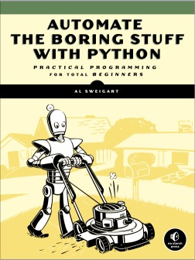
A better understanding of the possibilities of Excel
Automate your day!!!
Automate your day!!!
Martijn Poleij, Bertus van 't Wout
6 september 2022
This Photo by Unknown Author is licensed under CC BY
Notes:
Let’s all excel in Excel…

Slide 2
Our program for today
Introduction
A better understanding of…
    Useful formulas
    Text to columns
    Formula auditing
    Data validation
    Pivot tables
    Macros
    Simple VBA functions
Showcase of some Excel-tools
Wrap-up (10 minutes)
Notes:
Introductie, waarom deze presentatie
We merken dat te weinig collega’s slimme mogelijkheden van Excel niet benutten
Een doorkijkje van wat er kan, hoe makkelijk dat kan als je daar feeling voor hebt
We gaan een tipje van de sluier “we want to tell you a little bit more to inspire you all to
Livedemo…
Ad 6) Macrorecorder, goed stelen is beter dan slecht verzinnen
Ad 7) Functies dBround, KDMC > vastleggen kennis, eenduidig vastleggen van regelgeving
Ad 8) SOM-tool, toolbox geluid

Slide 3


Your hosts for today
Martijn Poleij
  GIS Specialist
  Mobility and Infrastructure NL South-West
  I like to automate my work with scripts or small tools in
  python, vba, flows, modelbuilder and Excel
Bertus van ‘t Wout
  Acoustical consultant for roadnoise
  Smart Urban Environment
  Our team has a lot of experience on handling data and programming
  Facilitator workstream Automation for Consultancy

Slide 4
Getting to know our audience…
We have prepared some questions:
  Go to www.menti.com or use the app
  Enter the code and give your answer
What do you like about Excel​ | 2744 9707​
What is your most frustrating experience in daily work?​ | 6290 6784​
Do you program in Excel? | 3144 9802 ​
Do you use Excel as a database​? | 1931 1355​
Anything you’d like to know more about? ​ | 8214 4818 ​

Slide 5

Questions ?
About the topics we present?
  Don’t hesitate to ask!
Other topics?
  Save them for the wrap-up…
  If enough time left, we will discuss them.
  If not, we will answer your questions in this presentation (which we will share)

Slide 6
Useful formulas
Vlookup
  Use when you need to find values in a table or a range by row.
Hlookup
  Use when you need to find values in a table or a range by column.
Sumif
  Summarize all values if a condition met
Countif
  Count all rows if a condition met

Slide 7
Useful formulas
Concatenate & Textjoin
  Combine text from different cells to 1 text
    Concatenate (old)
    “&”
    Textjoin (with delimiter)
Sumproduct
  Use arrays to calculate total amounts
Indirect
  Combines cell-information to a reference to a range
  Example: retrieve data for several sheets

Slide 8
Functies om te laten zien
Vlookup/Hlookup
Sumif, countif
  Voorbeeldje met verzameltabellen woningen
Indirect om adressen samen te stellen uit velden
  Goed bruikbaar om snel tabellen te kunnen koppelen
Concatenate > samenstellen of & teken
Conditional formatting met formules
Sumproduct

Slide 9
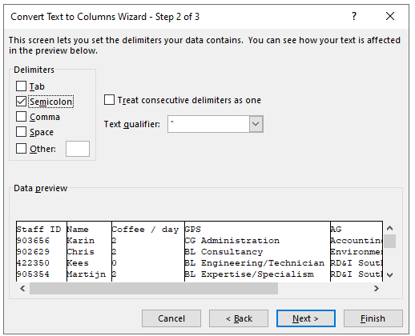
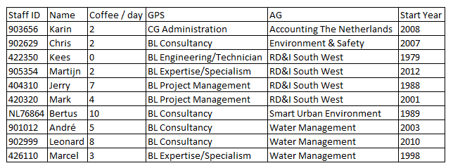
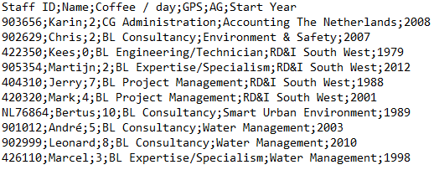
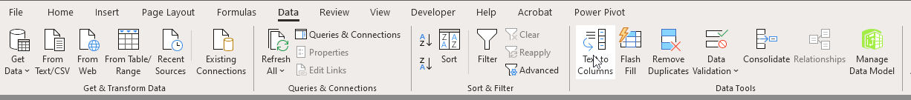
Text to Columns
Convert data in text format to a table

Slide 10
Formula Auditing
Quick visual check of formulas
  Precedents: Shows the source cells used in for a formula;
  Dependents: Shows all cells effected by a formula;

Slide 11
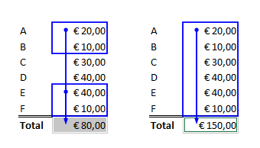
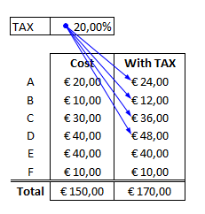
Formula Auditing - Examples
Check whether the total of an estimate includes all costs
(Precedents)
Check where a variable is used in a sheet

Slide 12
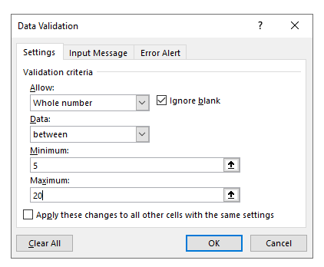
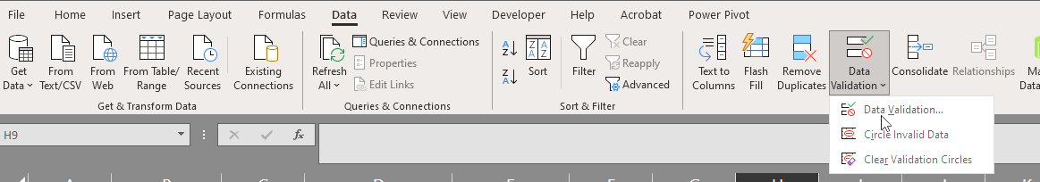
Data validation
Limit the values users can use in a cell
  Value: Minimum / Maximum / Decimals
  Format: Number / Date / Text
  Fixed: Drop-down
What to do with other values:
  Do not allow other values
  Allow and show an error
  Allow and ignore

Slide 13
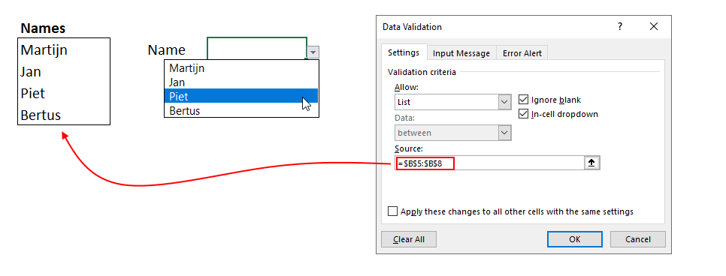
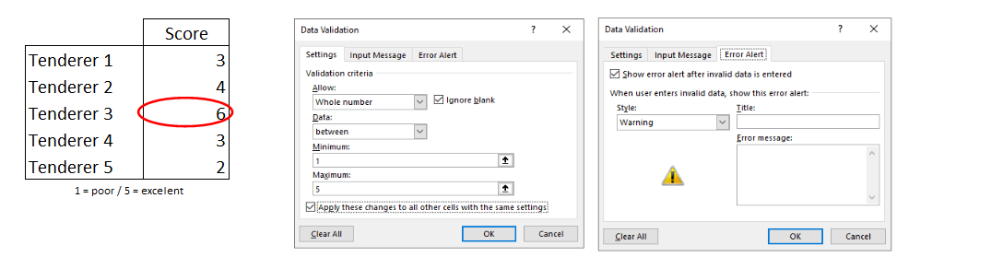
Data validation - Examples
Dropdown with names
Value range
(and show errors)

Slide 14
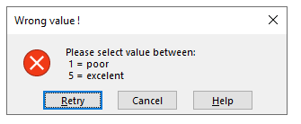
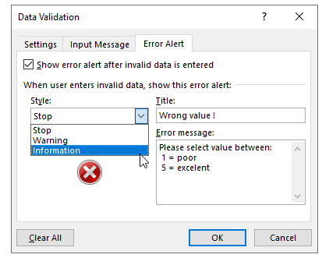
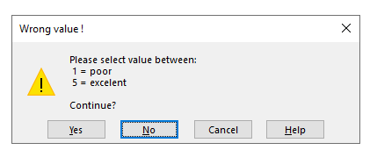
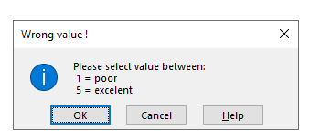
Data validation - Examples
Set a custom message, and options

Slide 15
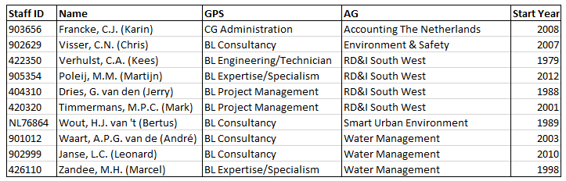
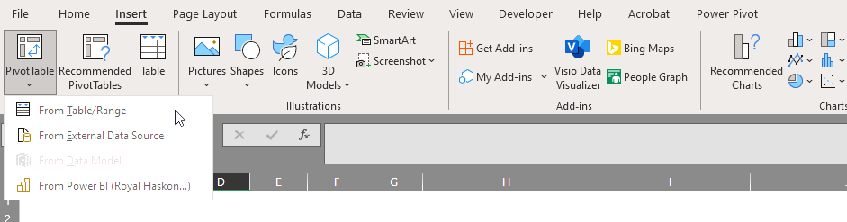
Pivot table
Order, summarize, filter and calculate statistics of large tables
Dynamic link to table
Needs data with unique named columns and data
  Excels ‘Table’ is optional

Slide 16
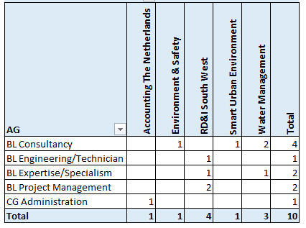
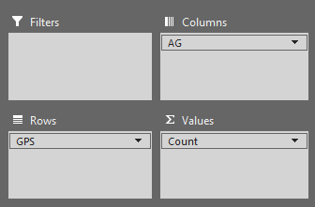
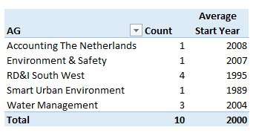
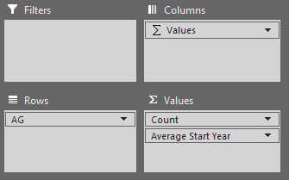
Pivot table - Example

Slide 17
What are macro’s
To start simple…
  To automate repetitive tasks
The next step
  Create your own functions to use
    In stead of extensive formulas
    To certify your procedures
Or even more…
  To make a user-interface to manage your workflow
  To create your own tooling

Slide 18
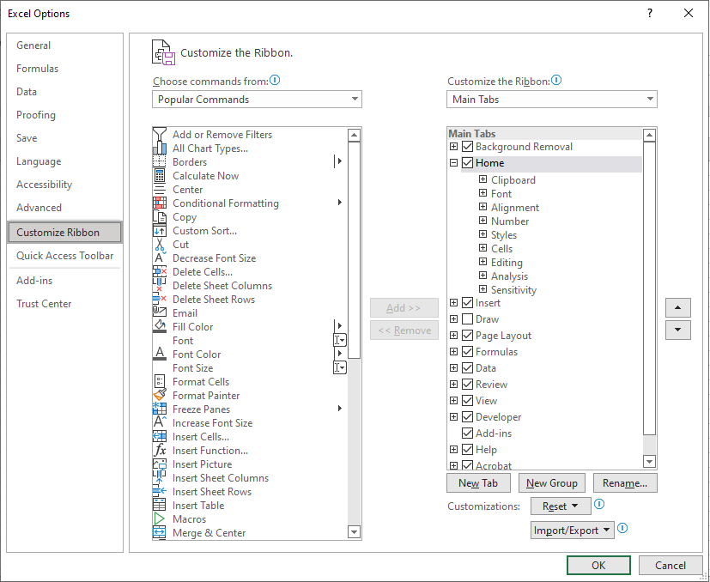
Record your own macro
Excel has a built-in macrorecorder to record your keystrokes and mouseclicks
Macro-recorder is in de Developer-tab
If not visible, make it visible:
  File-Options-Customize ribbon
  Right click menu and choose Customize the Ribbon

Slide 19
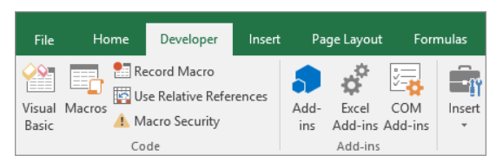
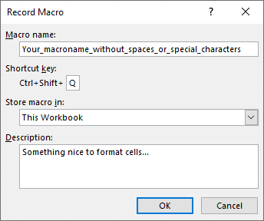
Record with the Developer-tab
Give it a clear name
Give it a shortcut
Tip: use Shift not to overwrite existing shortcuts
Where to store it…
Optional but may turn out useful…
Press OK and do the things you want to do…

Slide 20
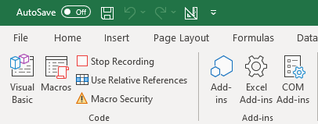
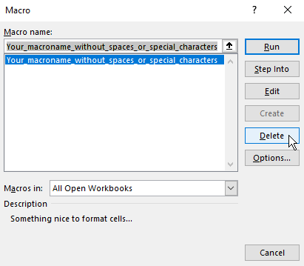
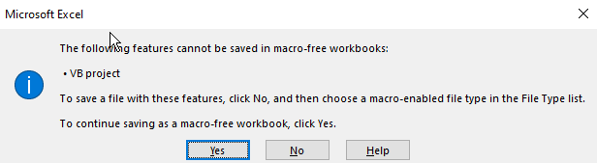
When finished
Press Stop Recording and your macro is recorded
How to run the macro?
  Choose Macros
  Select your macro
  Run the macro
Note: workbooks with macro’s have to be saved as macro enabled workbooks

Slide 21
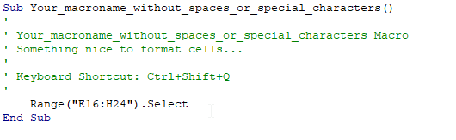
Where are macro’s stored
As subroutines in Visual Basic
Edit it to modify it to your needs…
Record short macros to find out how to do things…
Good examples can be found on the internet, for example www.excel-easy.com

Slide 22
Macros are absolute..
Macros work by default on absolute cell adresses
It is possible to have them start in the activecell: Use Relative References

Slide 23
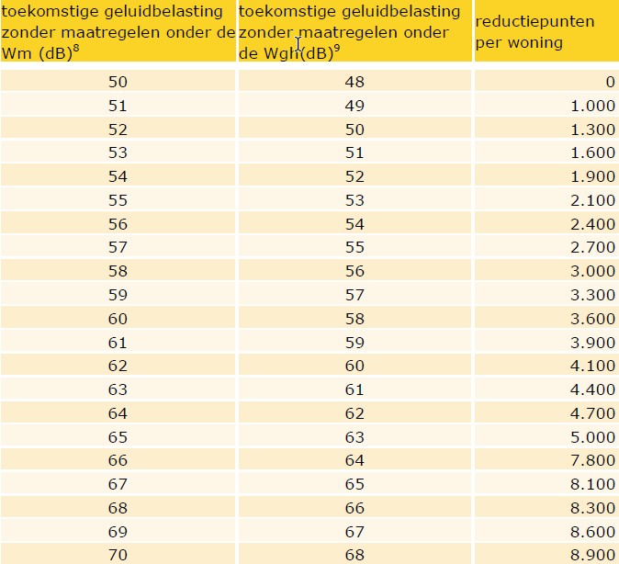
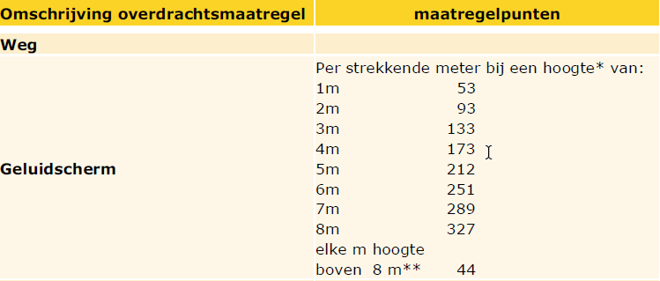
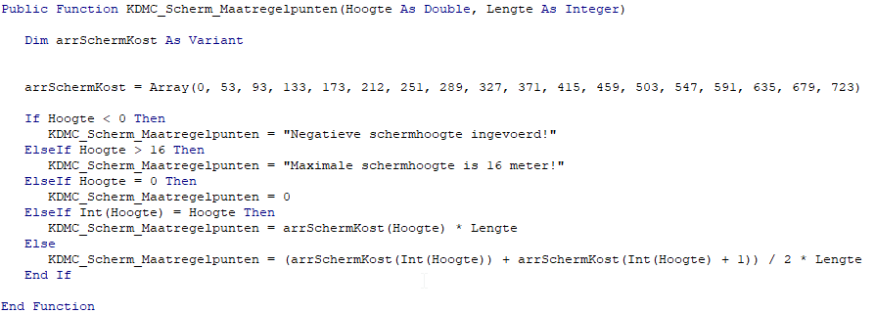
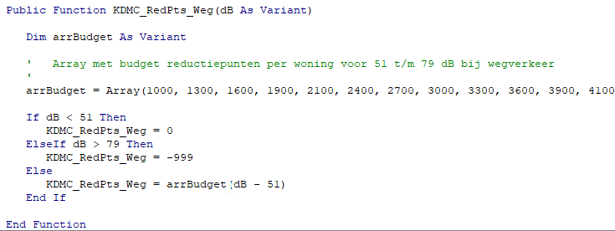
Easy accesible functions
Using functions secures your work procedures
Prevent typing errors and very difficult structures with multiple if/thens and parenthesis
Implement single source of truth for regulation

Slide 24
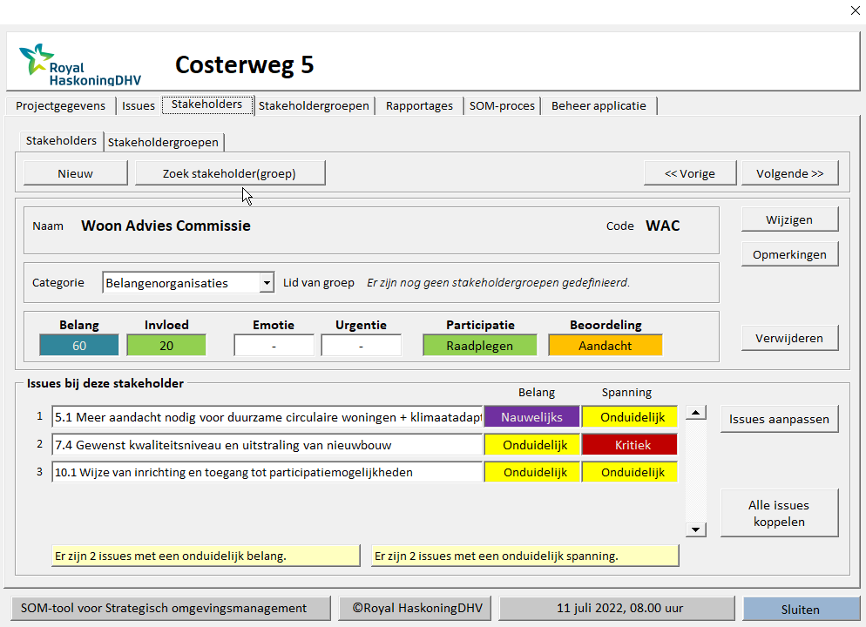
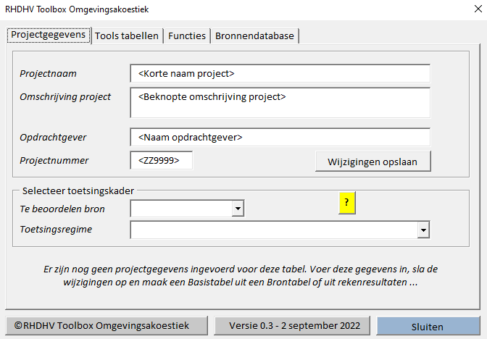
Examples
SOM-tool
  Tool for strategical environmental management
  Link issues to stakeholders and classify them
  Smart interface to manipulate and combine data
Add-in for noise projects
  Define workflow
  Standard toolbox for noise-tooling
  Make legislation accessible

Slide 25

Wrap up and questions?
This Photo by Unknown Author is licensed under CC BY-SA-NC

